Slide 1
Differentially Private Data Analysis of Social Networks via Restricted Sensitivity
Jeremiah Blocki
Avrim Blum
Anupam Datta
Or Sheffet

Slide 2

Goal
useful statistics
Preserve Privacy and Release Useful Statistics

Slide 3
Outline
Background
  Social Networks
  Differential Privacy
The Problem
Restricted Sensitivity
Algorithms
Notes:
General Inefficient Construction
Bounded Degree Assumption
Edge Adjacency Construction
Vertex Adjacency Construction

Slide 4
Social Network
Vertices in a social network G  G are labeled (e.g., doctor, lawyer, professor).

Slide 5

Differential Privacy (Dwork et al)
An algorithm A satisfies (,)-differential privacy for social networks if for any S  Range(A)
Pr[A(G)S] ≤ e Pr[A(G’)S] + 
for every neighboring social networks GG’  G.
Important Question: When are G and G’ are neighbors?
Notes:
Intuition before mathematical definition?

Slide 6
Edge Adjacency
_{e}
_{e}
Notes:
The first network is a neighbor because we change the label of one node.
The second network is a neighbor because we removed one edge.
The third network is not a neighbor because we removed two edges.

Slide 7





Edge Adjacency
G₁
G₂
_{e}
Pr[A(G₁)= ] ≤ePr[A(G₂)= ] + 
Notes:
If a mechanism A satisfies differential privacy then the mechanism must produce similar distributions over both graphs.
Intuition: Johnny’s mom may be able tell if he watched an R-rated movie.

Slide 8
Edge Adjacency
G₁
G₂
_{e}
Johnny’s mom cannot tell if he watched Saw.
Notes:
If a mechanism A satisfies differential privacy then the mechanism must produce similar distributions over both graphs.
Intuition: Johnny’s mom may be able tell if he watched an R-rated movie.

Slide 9

Edge Adjacency
G₁
G₂
_{e}
…
…
Johnny’s mom may be able tell if he watches R-rated movies.
Notes:
Now the graphs are not neighbors

Slide 10
Vertex Adjacency
_{v}
_{v}
_{v}
_{v}
Notes:
The first two graphs (right) are still neighbors.
The bottom graph now is a neighbor because we only removed edges incident to blue.
In fact the bottom right graph is also a neighbor for the same reason.
However, if we remove another edge then the graph is no longer a neighbor.

Slide 11
Vertex Adjacency
G₁
G₂
_{v}
…
…
Pr[A(G₁)= ] ≤ePr[A(G₂)= ] + 
Notes:
Popup:Differential Privacy wrt Vertex Adjacency is a stronger privacy guarantee

Slide 12
Vertex Adjacency
G₁
G₂
_{v}
…
…
Johnny’s mom cannot tell if he watches R-rated movies.
Notes:
Popup:Differential Privacy wrt Vertex Adjacency is a stronger privacy guarantee

Slide 13
Previous Work
Edge Adjacency Model
  Degree Distribution [HLM’09]
  Cut Queries [BBDS’12]
  Subgraph Counting [KRSY’11]
This Work: Vertex Adjacency
Notes:
[14] M. Hay, C. Li, G. Miklau, and D. Jensen. Accurate estimation of the degree distribution of
private networks. In ICDM, pages 169–178, 2009.
[5] J. Blocki, A. Blum, A. Datta, and O. Sheffet. The johnson-lindenstrauss transform itself preserves
differential privacy. In Proceedings of the 53rd annual IEEE Symposium on Foundations
of Computer Science. IEEE, 2012.
[16] V. Karwa, S. Raskhodnikova, A. Smith, and G. Yaroslavtsev. Private analysis of graph structure.
PVLDB, 4(11):1146–1157, 2011.

Slide 14
Outline
Background
The Problem
  Interesting Queries
  Sensitivity of a Query
  Interesting Queries have High Sensitivity
Restricted Sensitivity
Algorithms
Notes:
General Inefficient Construction
Bounded Degree Assumption
Edge Adjacency Construction
Vertex Adjacency Construction

Slide 15
Local Profile Query
How many people know 2 lawyers who know each other and 2 doctors who know each other, but the lawyers aren’t friends with the doctors?
Notes:
The local profile of blue depends only on the graph induced by blue and any adjacent vertices
Examples: Clustering Coefficient, Bridges etc…

Slide 16
Subgraph Counting Queries
How many copies of K₃ does Facebook contain where one node is a doctor, one node is a professor and one node is a lawyer?
Notes:
Clustering coefficient/triadic closure

Slide 17
Global Sensitivity
f(G) = “how many people in G know two pianists?”
G₁
G₂
GS_{f} = n
_{v}
f(G₁) = 0
f(G₂) = n

Slide 18
Global Sensitivity
Global Sensitivity of f:
Local Profile Queries (f):
GS_{f} = n
Notes:
Define Global Sensitivity from Scratch then motivate local sensitivity then smooth sensitivity

Slide 19
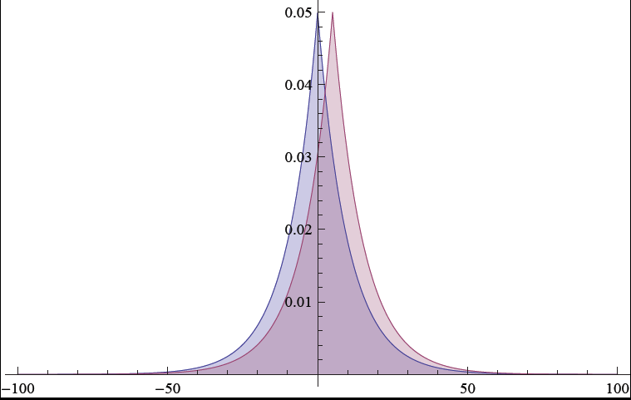
Laplacian Mechanism
The mechanism
A(G) = f(G) + Lap(GS_{f}/),
satisfies (,0)-differential privacy.

Slide 20



Privacy vs. Accuracy
A(G) = f(G) + Lap(n/)
Private, ….
but not accurate!

Slide 21
Local Sensitivity
f(G) = “how many people in G know two pianists?”
G₁
G₂
LS_{f}(G₁) = 1
_{v}
f(G₁) = 0
f(G₂) = 1

Slide 22

Local Sensitivity
Local Sensitivity of f at G:
LS_{f}(G) = max_{G~G’} |f(G)-f(G’) |
The mechanism
A(G) = f(G) + Lap(LS_{f}(G)/)
does not satisfy differential privacy.

Slide 23
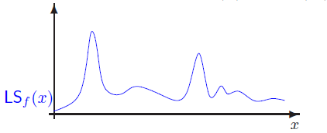
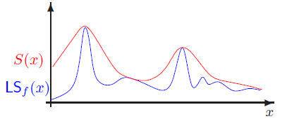
Smooth Sensitivity (Nissim et al)
Problem: LS_{f}(G) itself could be highly sensitive!

Slide 24
Smooth Sensitivity (Nissim et al)
A -smooth upper bound on the local sensitivity S_{f,} satisfies
S_{f,}(G)  LS_{f}(G) for all G  G.
S_{f,}(G) ≤ e S_{f,}(G’) for all G’~G.
Theorem: The mechanism A(G) = f(G) + Lap(2 S_{f,}(G) /)
satisfies (, )-differential privacy with =-/2 ln .
Notes:
Motivate Smooth Sensitivity with a Picture from Adam Smith’s Talk
Upper bound on Local Sensitivity
Smoothness

Slide 25
Smooth Sensitivity
A -smooth upper bound on the local sensitivity S_{f,} satisfies
S_{f,}(G)  LS_{f}(G) for all G  G.
S_{f,}(G) ≤ e S_{f,}(G’) for all G’~G.
When is S_{f,}(G) small?
LS_{f}(G) must be small.
For any nearby graph G’, LS_{f}(G’) must also be small.
Notes:
So does smooth sensitivity solve our problem? Not quite. In our example, neither condition (1) or (2) is satisfied.

Slide 26
Smooth Sensitivity is High!
f(G) = “how many people in G know a pianist?”
G₁
G₂
f(G₁)=0
f(G₂)=n
_{v}
Accuracy
Privacy
No private mechanism A can be accurate for both G₁ and G₂!

Slide 27
Hopeless?
f(G) = “how many people know two pianists who are friends with each other.”
G₁
G₂
f(G₁)=n-2
f(G₂)=0
Accuracy
Privacy
No private mechanism A can be accurate for both G₁ and G₂!
Notes:
Even Smooth Sensitivity cannot help, because the local sensitivity is already too high!
Notice that every graph G is close to a graph G’ with f(G’) = n. Either f(G) = n or we are close to an instance with high local sensitivity!

Slide 28
Outline
Background
The Problem
Restricted Sensitivity
  Lower Sensitivity for Interesting Queries
  Challenges in Designing Mechanisms
  Relaxed Accuracy Goal
Algorithms
Notes:
A new sensitivity definition
Demonstrate that it has lower sensitivity
Challenge to leverage this idea
Relaxed Accuracy Goals

Slide 29
Restricted Sensitivity
Hypothesis: H  G
Notes:
Highlight, contained in H. Split slides

Slide 30
Bounded Degree Hypothesis
Bounded Degree Hypothesis:
H_{k} = { G | max_{v V(G)} deg(v) ≤ k}
Typical:
G
H₂
Notes:
Think of k = Sqrt(n). There are 900 million facebook users, but very few have degree > 5,000. Sqrt(900 million) = 30,000

Slide 31
Restricted Sensitivity RS_{f}(H_{k})
Fact: For local profile queries f, RS_{f}(H_{k}) ≤ 2k+1
k= 2
k=2
G₁
G₂
|f(G₁) –f(G₂)|≤ 5=RS_{f}(H₂)
Notes:
Proof by example. (Point at red node).
The local profile of the red not can change
The local profile of the old neighbors can change
The local profile of new neighbors can change
All other local profiles are identical.

Slide 32
Sensitivity over H_{k}
 | Local Profile Query |  | Subgraph Counting Query (P)
Adjacency | Smooth | Restricted | Smooth | Restricted
Edge | k+1 | k+1 | O(|P| k^{|P|-1}) | O(|P| k^{|P|-1})
Vertex | n | 2k+1 | O(n^{|P|-1}) | O(|P| k^{|P|-1})
Notes:
Circle n and 2k+1

Slide 33
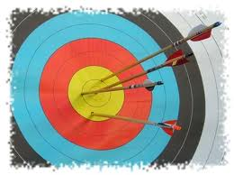
Restricted Sensitivity
For k << n the mechanism
A(G) = f(G) + Lap(RS_{f}(H_{k})/)
is accurate!
The mechanism
A(G) = f(G) + Lap(RS_{f}(H)/)
does not satisfy differential privacy for all G.
Notes:
Key Problem: How do we answer for G not in H?

Slide 34
f(G) = “how many people in G know a pianist?”
G₂  H_{k}.
f(G₂)=n
G₁
G₁  H_{k}.
f(G₁) = 0
G₂
Pr[A(G₁)  0] ≤ e Pr[A(G₂)  0] + 

Slide 35
Privacy for All, Accuracy for Some
H
useful data, released to the public
Privacy for all G
Accurate statistics for G  H

Slide 36
Outline
Background
The Problem
Restricted Sensitivity
Algorithms
  General Template
  Possibility: A General Inefficient Algorithm
  Efficient Algorithms for H_{k} via Projections
Notes:
General Inefficient Construction
Bounded Degree Assumption
Edge Adjacency Construction
Vertex Adjacency Construction

Slide 37
Accuracy for Some
f
f_{H}
Hypothesis (H)
G₁
H
For GH, we can
define f_{H}(G) to
minimize sensitivity.
For GH f(G)=f_{H}(G)
Notes:
If we achieve this goal then…

Slide 38
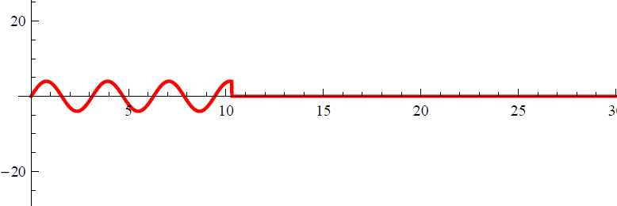
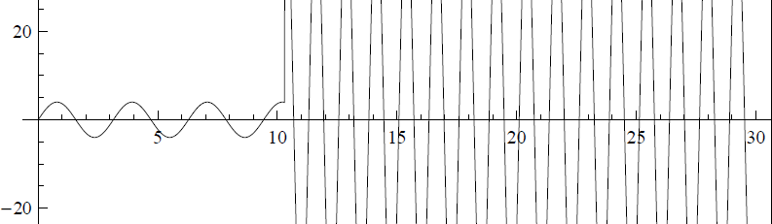
Accuracy for Some
f
f_{H}
Hypothesis (H)
f_{H}
f
H
Notes:
If we achieve this goal then…

Slide 39
Privacy For All
f
f_{H}
Hypothesis (H)
Answer f_{H} in a differentially private manner.
Ideally, we would like to compute f_{H} efficiently.
Notes:
If we achieve this goal then…

Slide 40
Outline
Background
The Problem
Restricted Sensitivity
Algorithms
  General Template
  Possibility: A General Inefficient Algorithm
  Efficient Algorithm for H_{k} via Projections
Notes:
General Inefficient Construction
Bounded Degree Assumption
Edge Adjacency Construction
Vertex Adjacency Construction

Slide 41
General Construction of f_{H}
Consider a canonical ordering G₁,G₂,… over all social networks(G).
  For G_{i}  H set f_{H}(G_{i}) = f(G_{i})
  Find
f_{H}(G_{j})
  I_{j}
d(G_{i},G_{j})RS_{f}(H)
d(G_{i},G_{j})RS_{f}(H)
Notes:
Backup slide (picture)

Slide 42
f(G_{i})
f(G_{j})
d(G_{i},G_{j})RS_{f}(H)
d(G_{i},G_{j})RS_{f}(H)

Slide 43
Suppose for contradiction that no value exists….
Can find two nonintersecting intervals I_{j} and I_{k} (j,k < i).
f(G_{j})
f(G_{k})
d(G_{i},G_{j})RS_{f}(H)
d(G_{i},G_{k})RS_{f}(H)

Slide 44
Can Find Non Intersecting Intervals

Slide 45
Suppose for contradiction that no value exists….
Triangle Inequality
Contradiction of Inductive Hypothesis!
G_{i}
G_{k}
G_{j}

Slide 46
Suppose for contradiction that no value exists….
Then there must exist two intervals which don’t intersect (j,k < i).

Slide 47
Suppose for contradiction that no value exists….
Triangle Inequality
Contradiction of Inductive Hypothesis!

Slide 48
General Construction of f_{H}
Theorem: f_{H} satisfies
  f_{H}(G) = f(G) for all G  H
  GS_{fH} = RS_{f}(H)
Disclaimer: The general construction of f_{H} is not efficient.
Notes:
Works for any query, and any hypothesis H

Slide 49
Outline
Differential Privacy in Social Networks
The Problem
Restricted Sensitivity
Algorithms
  General Template
  Possibility: A General Inefficient Algorithm
  Efficient Algorithms for H_{k} via Projections
    Edge Adjacency Model
    Vertex Adjacency
Notes:
General Inefficient Construction
Bounded Degree Assumption
Edge Adjacency Construction
Vertex Adjacency Construction

Slide 50
Projection onto H
: G H
G₁
H
(G₁)
G₂ = (G₂)

Slide 51
c-smooth Projection
: G H
d
G₁
G₂
❍
H
❍
(G₁)
(G₂)
c d

Slide 52
c-smooth Projection Lemma
Let : G H be a c-smooth projection then f_{H}(G) = f((G)) satisfies:
For G  H, f_{H}(G) = f(G), and
GS_{fH}≤ c RS_{f}(H).
Notes:
The first claim is trivial.

Slide 53
Proof of (1)
(1) For G  H, f_{H}(G) = f(G),
H
G₂ = (G₂)
f_{H}(G₂) = f((G₂))
= f(G₂)

Slide 54
Proof of (2)
: G H
d
G₁
G₂
❍
H
❍
(G₁)
(G₂)
c d
| f_{H}(G₁) -f_{H}(G₂)| = |f((G₁)) - f((G₂))|
≤ d((G₁), (G₂)) RS_{f}(H)/d
≤ c RS_{f}(H)
Notes:
The second claim immediately follows from the definition of c-smooth projection and restricted sensitivity.

Slide 55
Outline
Differential Privacy in Social Networks
The Problem
Restricted Sensitivity
Algorithms
  General Template
  Possibility: A General Inefficient Algorithm
  Efficient Algorithms for H_{k} via Projections
    Edge Adjacency Model
    Vertex Adjacency
Notes:
General Inefficient Construction
Bounded Degree Assumption
Edge Adjacency Construction
Vertex Adjacency Construction

Slide 56
Edge Adjacency (: G H_{k})
For each vertex v with deg(v) > k:
  Let (v,u₁),…,(v, u_{deg(v)}) denote the edges incident to v in canonical order
  Mark the edge (v,u_{i}) for each i > k.
Delete all marked edges.
Call the resulting graph (G).

Slide 57
Edge Adjacency (: G H_{k})
Claim: The efficiently computable mapping (G) is a 3-smooth projection.
Proof:
(1) If G  H_{k} then no edges are deleted so (G)=G.
(2) WTS: For any G~G’, d((G), (G’)) ≤ 3.

Slide 58
Edge Adjacency (: G H_{k})
(2) For any G~G’, d((G), (G’)) ≤ 3.
Proof:
If E(G’) = E(G)+(u,v) then
  (G’) might still contain (u,v).
  At most one edge (u,w₁)  E((G))\ E(G’).
  At most one edge (v,w₂)  E((G))\ E(G’).
  So d((G), (G’)) ≤ 3.
  (QED)

Slide 59
Outline
Differential Privacy in Social Networks
The Problem
Restricted Sensitivity
Algorithms
  General Template
  Possibility: A General Inefficient Algorithm
  Efficient Algorithms for H_{k} via Projections
Notes:
Black diamond: warning

Slide 60
Naïve Projection
: G H
G₁
H_{k}
(G₁)
G₂ = (G₂)

Slide 61
Map Close Graphs to Close Graphs
: G H
d
G₁
G₂
❍
H
❍
(G₁)
(G₂)
c d

Slide 62
Projection Lemma
Let : G H be a projection such that
For G  H, (G) = G, and
For G~G’, d((G), (G))  c
then f_{H}(G) = f((G)) satisfies:
For G  H, f_{H}(G) = f(G), and
GS_{fH}≤ c RS_{f}(H).
Works in the edge adjacency model!
Notes:
The first claim is trivial.

Slide 63
Vertex Adjacency?
Map close graphs to close graphs in H_{k}?
  Worked for Edge Adjacency Model
Can’t Work! ☹ Why?
It would allow us to approximate d(G,H_{k}).
Claim: It is NP-hard to approximate d(G,H_{k}) to within any constant factor (reduction from set cover)

Slide 64
Reduction from Set Cover
…
Universe (n ≤ k items)
Sets (m ≤ k)
S₁
S₁
…
d(G,H_{k})= Size of Optimal Set Cover
…
…
…
S_{m}
S_{m}
Degree = k+1

Slide 65
A New Approach
f
Hypothesis (H)
f_{H}
Leverage Smooth Sensitivity!
Notes:
Relaxation: S_{f} may be large when we are far away from H

Slide 66
Privacy For All
Theorem: The mechanism
preserves differential privacy for =-/2 ln .

Slide 67
Goal: Accuracy For Some
For Local Profile Queries

Slide 68
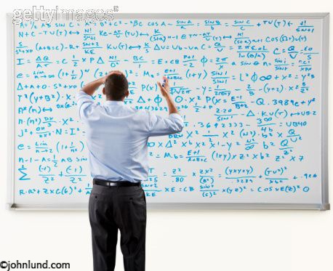
Warning!
Remaining slides are mathematically dense!

Slide 69
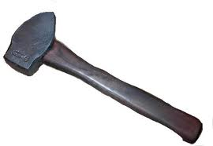

High Level Picture
Concept: c-Smooth Distance Estimation
Lemma
  Accuracy for Some
Constructing a 4-Smooth Distance Estimator
  LP Rounding

Slide 70
c-Smooth Distance Estimation
d
G₁
G₂
d_{est}(G₁) ≥ d(G₁, (G₁))
H_{2k}
≤ c d(G₁,H_{k})
H_{k}
≤ c d(G₁,H_{k})
(G₂)
(G₁)
( G) = G
d_{est}(G) = 0
C-smooth  |d_{est}(G₁)- d_{est}(G₂)| ≤ c d

Slide 71
c-Smooth Distance Estimation
Definition: Let : G H_{2k} be an efficiently computable projection and let d_{est} be an efficiently computable function which satisfies
For G  H_{k}, d_{est}(G) = 0,
d_{est}(G) ≥ d(G, (G)), and
|d_{est}(G)- d_{est}(G’)| ≤ c for G~G’,
then d_{est} is a c-smooth distance estimator.
Notes:
Outline Slides

Slide 72
High Level Picture
Concept: c-Smooth Distance Estimation
Lemma
  Privacy for All, Accuracy for Some
Constructing a 4-Smooth Distance Estimator
  LP Rounding

Slide 73
c-Smooth Distance Estimation
: G H_{2k}
1
G₁
G₂
d_{est}(G₁)
H_{2k}
d_{est}(G₂) ≤d_{est}(G₁) + c
≤ c d(G₁,H_{k})
(G₁)
(G₂)
≤ 2 d_{est}(G₁) + c + 1
Notes:
Intuition: The Local Sensitivity grows with distance from H_{k}. Graphs close to H_{k} have low sensitivity. Graphs with high sensitivity must be far away from

Slide 74
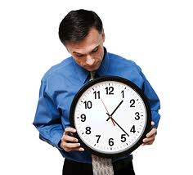
Smooth Sensitivity
Fact 1:
Fact 2: is -smooth.
Fact 3:
Notes:
Fact 1 and 2 say that S is a valid smooth upper bound (privacy for all). Fact 3 satisfies accuracy for some.

Slide 75
c-Smooth Distance Estimation Lemma
Let : G H_{2k} be a projection with a c-smooth distance estimator d_{est}, and let
Then for every G  H_{k}
Notes:
Furthermore, are both efficiently computable.

Slide 76
Smooth Upper Bound
Fact 1:
Notes:
Plug in d = d_{est}(G)
Exp(0) = 1
Apply the definition of restricted sensitivity
4. Apply fact about c-smooth projections: 2d_{est}(G)+c+1 >= d(G,G’)

Slide 77
Smooth Upper Bound
Fact 1:
Notes:
5. Simplify and apply definition of f_{H}
6. By definition of LS_{f}

Slide 78
Smooth Upper Bound
Fact 2: is -smooth.
Notes:
1. The maximum in the numerator is obtained at some value d*

Slide 79
Smooth Upper Bound
Fact 2: is -smooth.
Notes:
2. We can substitute d* into the denominator and obtain the following inequality

Slide 80
Smooth Upper Bound
Fact 2: is -smooth.
Notes:
3. Simply

Slide 81
Smooth Upper Bound
Fact 2: is -smooth.
Notes:
4. Simplify

Slide 82
Smooth Upper Bound
Fact 2: is -smooth.
Notes:
5. By definition of c-smoothness

Slide 83
Smooth Upper Bound
Fact 3:
Calculus
Where

Slide 84
Smooth Upper Bound
Fact 3:
Notes:
By c-smoothness for all G in H_{k} we have d_{est}(G) = 0.
Too much math

Slide 85
High Level Picture
Concept: c-Smooth Distance Estimation
Lemma
  Privacy for All, Accuracy for Some
Constructing a 4-Smooth Distance Estimator
  LP Rounding

Slide 86
c-Smooth Distance Estimation
: G H_{2k}
d(G₁, G₂)=1
G₁
G₂
d_{est}(G₁) ≤ d(G₁,(G₁))
H_{2k}
d_{est}(G₂)
≤ c d(G₂,H_{k})
≤ c d(G₁,H_{k})
(G₁)
(G₂)
C-smooth  |d_{est}(G₁)- d_{est}(G₂)| ≤ c

Slide 87
c-Smooth Distance Estimation via LP
Integral Intuitions
d(G, H_{k})
Proof: Let v be the vertex such that G-v = G’-v.
Solve LP for G, and set
  x_{v}* =1
  x_{u}* =x_{u} for uv
Now x* is a feasible LP solution for G’.
Delete v?
(u,v) cannot be deleted unless u or v is deleted.
(G)  H_{k}
4-Smooth:
Notes:
keep

Slide 88
Rounding the LP
1 If x_{v} ≥ ¼
y_{v}=
0 o.w.
0 If x_{v} ≥ ¼
e_{u,v} =
0 If x_{u} ≥ ¼
1 o.w.
e_{u,v}=1
w_{u,v}≥½

Slide 89
Rounding the LP
1 If x_{v} ≥ ¼
y_{v}=
0 o.w.
0 If x_{v} ≥ ¼
e_{u,v} =
0 If x_{u} ≥ ¼
1 o.w.
e_{u,v}=1
w_{u,v}≥½
Keep edge ⬄ e_{u,v} = 1
Call the resulting graph (G).

Slide 90
Rounding Facts
So d_{est} is 4-smooth distance estimator for !

Slide 91
Reminder
Let : G H_{2k} be a projection with a c-smooth distance estimator d_{est}, and let
Then for every G  H_{k}
Furthermore, are both efficiently computable.

Slide 92
Goal Met
Theorem: The efficiently computable mechanism
preserves differential privacy for =-/2 ln .

Slide 93
Summary
 | Adjacency | Hypothesis | Efficient? | Sensitivity of f_{H}
Alg 1 | Any | Any | No | RS_{f}(H)
Alg 2 | Edge | H_{k} | Yes | 3 RS_{f}(H_{k})
Alg 3 | Vertex | H_{k} | Yes | O(RS_{f}(H_{2k}))
 | Local Profile Query |  | Subgraph Counting Query (P)
Adjacency | Smooth | Restricted | Smooth | Restricted
Vertex | n | 2k+1 | O(n^{|P|-1}) | O(|P| k^{|P|-1})

Slide 94
Questions?

